Slide 1
Bayesian Modelling Workshop
4th Session – Latent Variable
April 21st, 2023

Slide 2
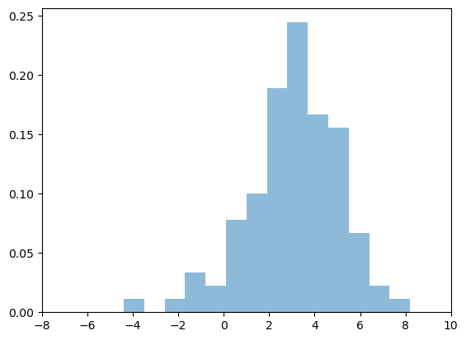
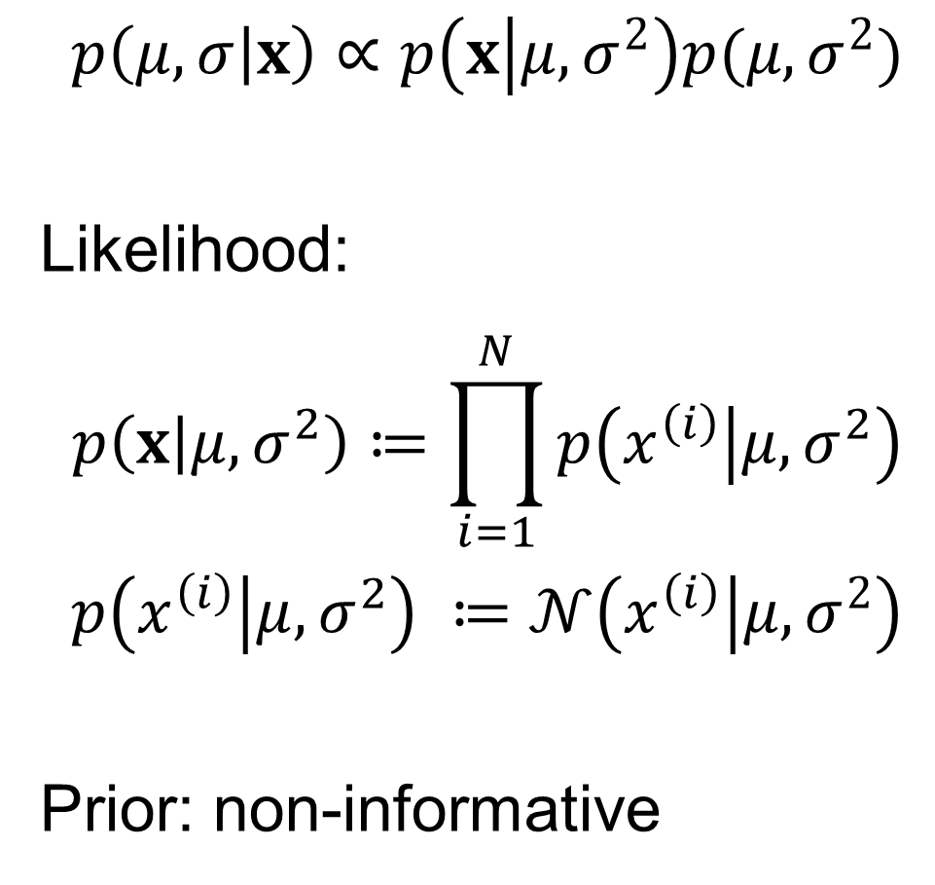
Gaussian Distribution
$$p\left(μ,σ | x\right)∝p\left(x | μ,σ^{2}\right)p(μ,σ^{2})$$
Likelihood:
$$p\left(x | μ,σ^{2}\right)≔\prod_{i=1}^{N}{p\left(x^{\left(i\right)} | μ,σ^{2}\right)}$$
$$p\left(x^{\left(i\right)} | μ,σ^{2}\right) ≔𝒩\left(x^{\left(i\right)} | μ,σ^{2}\right)$$
Prior: non-informative

Slide 3
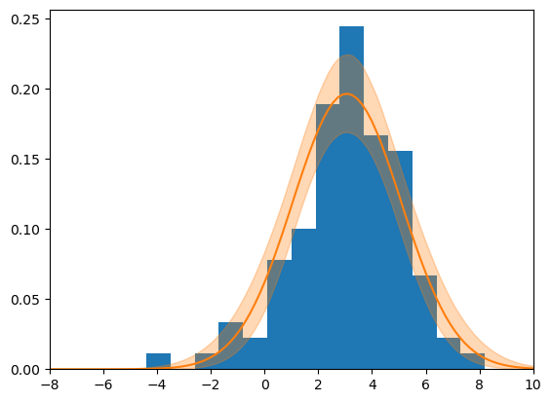
Gaussian Distribution

Slide 4
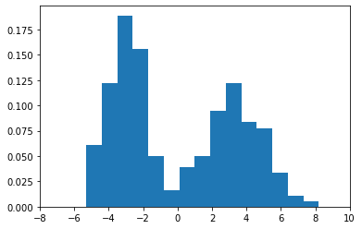
Gaussian Distribution

Slide 5
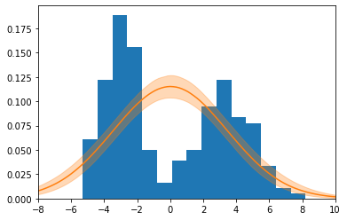
Gaussian Distribution

Slide 6
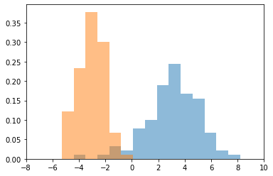
Gaussian Distribution
Notes:
$$𝒩\left(x_{1} | μ_{1},σ_{1}^{2}\right)$$
$$𝒩\left(x_{2} | μ_{2},σ_{2}^{2}\right)$$

Slide 7
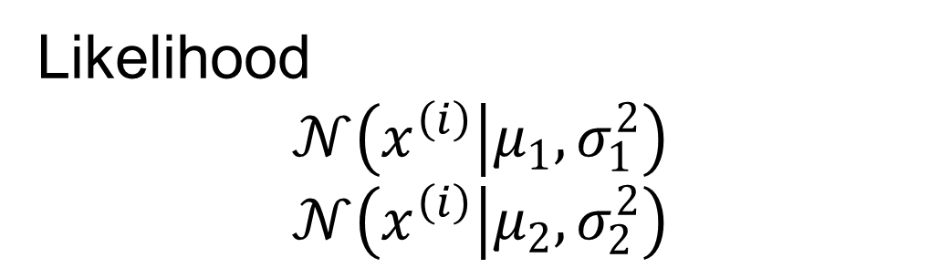
Gaussian Distribution
$$p\left(μ_{1},σ_{1},μ_{2},σ_{2} | x_{1},x_{2}\right)∝p\left(x_{1} | μ_{1},σ_{1}\right)p\left(x_{2} | μ_{2},σ_{2}\right)p(μ_{1},σ_{1},μ_{2},σ_{2})$$
Likelihood
$$𝒩\left(x^{\left(i\right)} | μ_{1},σ_{1}^{2}\right)$$
$$𝒩\left(x^{\left(i\right)} | μ_{2},σ_{2}^{2}\right)$$
Notes:
$$𝒩\left(x_{1} | μ_{1},σ_{1}^{2}\right)$$
$$𝒩\left(x_{2} | μ_{2},σ_{2}^{2}\right)$$

Slide 8
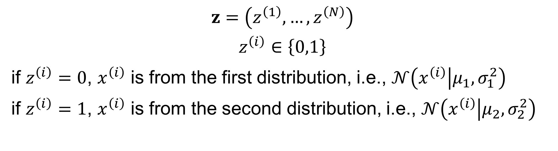
Gaussian Mixture
$$z=\left(z^{\left(1\right)},…,z^{\left(N\right)}\right)$$
$$z^{\left(i\right)}∈\left\{0,1\right\}$$
if $z^{\left(i\right)}=0$, $x^{\left(i\right)}$ is from the first distribution, i.e., $𝒩\left(x^{\left(i\right)} | μ_{1},σ_{1}^{2}\right)$
if $z^{\left(i\right)}=1$, $x^{\left(i\right)}$ is from the second distribution, i.e., $𝒩\left(x^{\left(i\right)} | μ_{2},σ_{2}^{2}\right)$
$$p\left(μ_{1},σ_{1},μ_{2},σ_{2},z | x\right)∝p\left(x | z,μ_{1},σ_{1},μ_{2},σ_{2}\right)p(z,μ_{1},σ_{1},μ_{2},σ_{2})$$

Slide 9
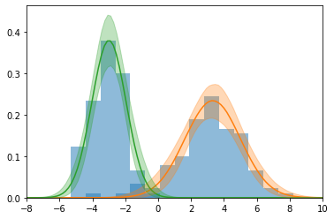
Gaussian Mixture

Slide 10
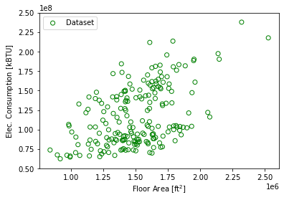
Mixture of Linear Models

Slide 11
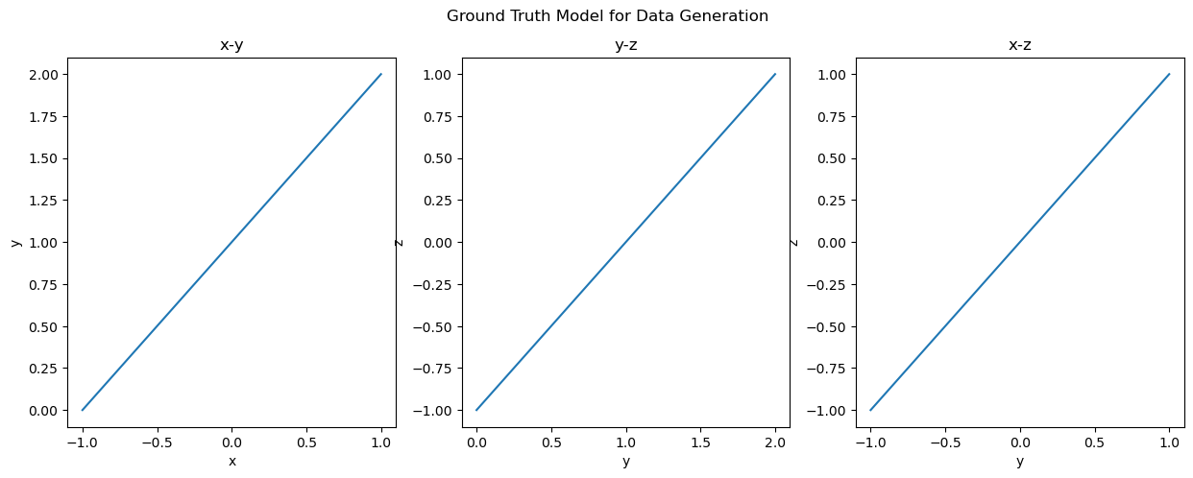

Another Example
x
y
z
$$y=1×x+1$$
$$z=1×y−1$$

Slide 12
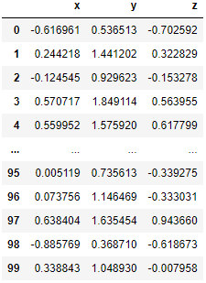
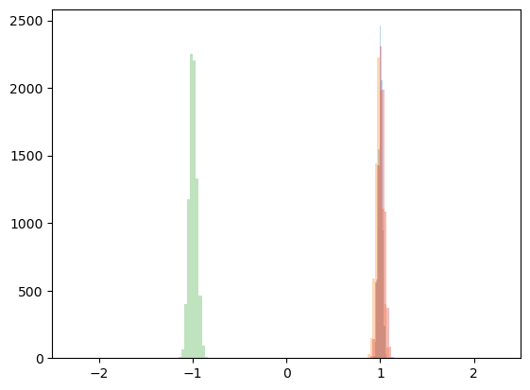
Another Example
x
y
z

Slide 13
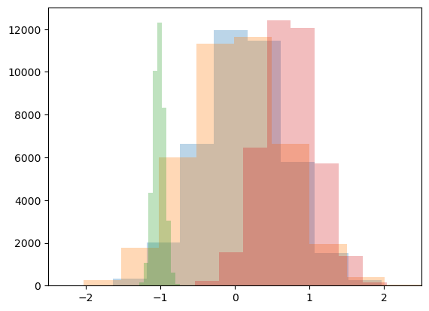
Another Example
x
y
z
NA
NA
NA
NA
NA
NA

Slide 14
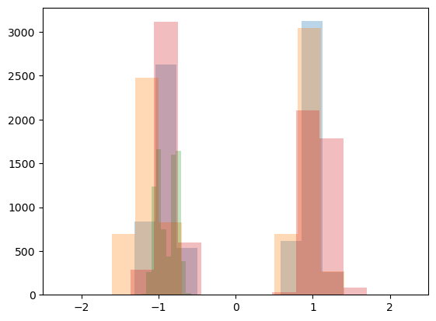
Another Example
x
y
z
NA
NA
NA
NA
NA
NA

Slide 15







GRID-INTERACTIVE CONTROL
ENERGY SYSTEM
OPTIMAL CONTROL
ENERGY & DATA
MANAGEMENT
FAULT DETECTION AND DIAGNOSIS
HUMAN-BUILDING INTERACTION
Thank you!
(sjae.lee@utoronto.ca)

